Slide 1


Department of Computer Science and Engineering
PREDICTION OF 8 STAGES OF KNEE OSTEOARTHIRITIS
Dr. T. Kumaragurubaran
Dean(Academics)
B21A2425C11
Madhumita P (210701140)
Kavyashree BN (210701702)

Slide 2
Problem Statement and Motivation
Osteoarthritis (OA) is a degenerative joint disease affecting millions worldwide, often leading to pain, reduced mobility, and diminished quality of life. Accurate and early diagnosis of OA is crucial for timely intervention and effective management.
Traditional diagnostic methods, including manual assessment of knee radiographs by radiologists, are time-consuming, subjective, and prone to variability. This highlights the need for an automated, reliable, and precise classification system to detect and classify the stages of OA.Real-time translation capabilities, scalability, and smooth integration are frequently absent from current options.

Slide 3
Problem Statement and Motivation
Developing a robust method leveraging advanced machine learning techniques, such as Convolutional Neural Networks (CNNs), poses challenges in achieving high classification accuracy and aligning with radiologist evaluations.
Additionally, the need for effective feature representation, model generalization, and overcoming data limitations necessitates innovative ensemble approaches. Addressing these issues is critical for enhancing OA diagnosis and supporting clinical decision-making.

Slide 4
Objectives
(1) to collect and preprocess a comprehensive dataset of knee images.
(2) to design and implement various CNN architectures
(3) to evaluate the performance of individual models and the ensemble method.
(4) to compare the results against traditional diagnostic methods to ascertain the improvements in classification accuracy.

Slide 5
Abstract
This study proposes a novel method for classifying the eight stages of knee osteoarthritis (OA) using Convolutional Neural Network (CNN) ensembles within the TensorFlow framework.
By leveraging diverse feature representations through multiple CNN architectures and ensemble techniques like bagging and boosting, the approach enhances classification accuracy and robustness.
Tested on a comprehensive dataset of knee radiographs, the model achieves state-of-the-art performance comparable to expert radiologists, demonstrating its potential for early diagnosis and clinical application.

Slide 6
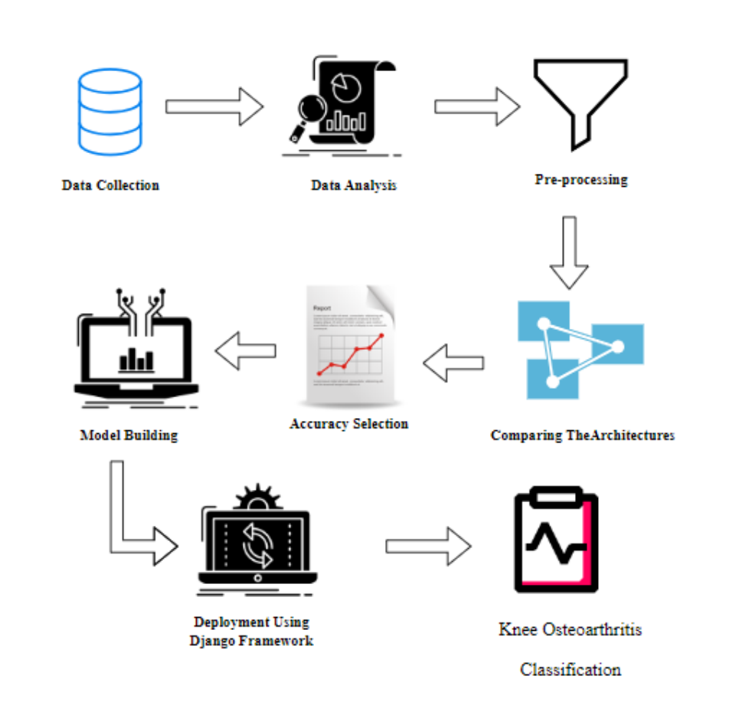
System Architecture

Slide 7
List of Modules
1. Manual Net
2. Xception Net
3. Shuffle Net
4. Deploy

Slide 8
EXISTING SYSTEM
The existing surface electromyography-based pattern recognition system (sEMG-PRS) exhibits limited generalizability in practical applications. In this paper, we propose a stacked weighted random forest (SWRF) algorithm to enhance the long-term usability and user adaptability of sEMG-PRS.
First, the weighted random forest (WRF) is proposed to address the issue of imbalanced performance in standard random forests (RF) caused by randomness in sampling and feature selection. Then, the stacking is employed to further enhance the generalizability of WRF.

Slide 9
EXISTING SYSTEM
Specifically, RF is utilized as the base learner, while WRF serves as the meta-leaning layer algorithm. The SWRF is evaluated against classical classification algorithms in both online experiments and offline datasets.
The offline experiments indicate that the SWRF achieves an average classification accuracy of 89.06%, outperforming RF, WRF, long short-term memory (LSTM), and support vector machine (SVM).
The online experiments indicate that SWRF outperforms the aforementioned algorithms regarding long-term usability and user adaptability. We believe that our method has significant potential for practical application in sEMG-PRS.

Slide 10
DRAWBACKS
1. Limited generalizability in practical applications due to surface electromyography-based pattern recognition system (sEMG-PRS).
2. Imbalanced performance in standard random forests (RF) caused by randomness in sampling and feature selection.
3. Potential issues with long-term usability and user adaptability.
4. May not achieve optimal classification accuracy compared to advanced algorithms.

Slide 11
PROPOSED SYSTEM
The proposed system employs an ensemble of Convolutional Neural Networks (CNNs) for the classification of knee osteoarthritis, utilizing Tensor Flow for implementation. This ensemble approach combines multiple CNN models to enhance diagnostic accuracy and robustness.
Each CNN in the ensemble is designed with several convolutional layers for feature extraction from MRI and X-ray images, followed by pooling layers to reduce spatial dimensions, and fully connected layers for classification. By integrating outputs from diverse CNN architectures, the system leverages the strengths of each model, achieving superior performance compared to any single model.
especially when dealing with limited medical imaging data. Data augmentation techniques are applied to improve generalization, making the system resilient to variations in image quality and patient demographics.
Real-time processing capabilities enable timely diagnosis, which is crucial for effective treatment planning. Tensor Flow’s scalability ensures the system can handle large dataset and be deployed across various clinical settings

Slide 12
PROPOSED SYSTEM
This ensemble CNN approach aims to significantly improve the early detection and classification of knee osteoarthritis, leading to better patient outcomes and more efficient healthcare delivery.

Slide 13
Advantages:
1. Enhanced diagnostic accuracy and robustness through an ensemble of Convolutional Neural Networks (CNNs).
2. Superior performance compared to any single model, especially with limited medical imaging data.
3. Integration of diverse CNN architectures to leverage the strengths of each model.
4. Improved generalization through data augmentation techniques, resilient to variations in image quality and patient demographics.
5. Improves accuracy level and Django web application implemented.

Slide 14
PREPARING THE DATASET:
This dataset contains lot of train and test image records of features extracted from knee osteoarthritis, which were then classified into to 8 classes.

Slide 15
LITERATURE SURVEY:
Title : Medical Image Analysis of Knee Osteoarthritis using Modified Deep CNN
Author: Mohammed Zakir Bellary, Deepthi
Year : 2023
Kellgren and Lawrence (KL) grading method is mainly used by the clinicians for grading the Xray images. However, grading individual images are prone to errors. This study proposes an approach for automated knee osteoarthritis classification based on deep neural networks. Diagnosis of Osteoarthritis involves splitting the knee X-ray into the healthy knee or unhealthy knee with KL grading. Here we use a 20-layer deep residual networks ie ResNet 20 for automated knee osteoarthritis classification. ResNet 20 has 19 convolutional layers and 1 fully-connected layer.We analysed the dataset with different CNN models. And got the different performance.

Slide 16
Title : Enhanced deep neural networks for early diagnosis of knee osteoarthritis
Author: Yassine Nasser
Year : 2023
K nee Osteoarthritis (OA) is one of the most frequent causes of physical disability worldwide and is associated with significant personal and socioeconomic burdens. There is a considerable need to develop automated methods for early diagnosis of knee OA. Over the last few years, Deep Learning (DL) models have gained remarkable attention from the computer vision research community and achieved great success in various medical imaging applications. This thesis aimed to develop DL-based models for fully automatic knee OA diagnosis using radiographic images. In this thesis, several methods for knee OA severity assessment and OA prediction are evaluated, and new methods are introduced. First, we focus on the feature-learning step as a crucial component of the classification system to learn and extract the most useful discriminative features from X-ray images. To do so, we introduce a novel autoencoder-based architecture called Discriminative Regularized Auto-encoder (DRAE). The goal is to maximize the distance between class features by minimizing the intraclass distance and maximizing the interclass distance. Then, we propose incorporating the proposed discriminative regularization in the standard Convolutional Neural Network (CNN) learning process to improve the early detection of knee OA. By doing so, we reduce the inability of CNNs to handle data with high inter-class similarities or high intra-class variations. While the proposed DRAE focuses on the texture information in the radiography under the tibial plateau, the second proposed learning model, called Discriminative Convolutional Neural Network (DCNN), uses the overall distal area of the knee and exploits both texture and shape representations. To further learn discriminative features and exploit shape and texture, we propose : (i) enhancing texture analysis by adding a new block to the DCNN architecture and (ii) improving the proposed discriminative loss to fit with multi-class classification tasks. The resulting model, called Discriminative Shape-Texture Convolutional Neural Network (DST-CNN), enables better and well-balanced classification performance than existing State-of-the-Art (SoA) model

Slide 17
Title : automatic detections of knee joints and classification of knee osteoarthritis severity form plain radiographs using cnns
Author: David duran olivar
Year : 2023
K nee Osteoarthritis (OA) is one of the most frequent causes of physical disability worldwide and is associated with significant personal and socioeconomic burdens. There is a considerable need to develop automated methods for early diagnosis of knee OA. Over the last few years, Deep Learning (DL) models have gained remarkable attention from the computer vision research community and achieved great success in various medical imaging applications. This thesis aimed to develop DL-based models for fully automatic knee OA diagnosis using radiographic images. In this thesis, several methods for knee OA severity assessment and OA prediction are evaluated, and new methods are introduced. First, we focus on the feature-learning step as a crucial component of the classification system to learn and extract the most useful discriminative features from X-ray images. To do so, we introduce a novel autoencoder-based architecture called Discriminative Regularized Auto-encoder (DRAE). The goal is to maximize the distance between class features by minimizing the intraclass distance and maximizing the interclass distance. Then, we propose incorporating the proposed discriminative regularization in the standard Convolutional Neural Network (CNN) learning process to improve the early detection of knee OA.

Slide 18
Title : Applying Densely Connected Convolutional Neural Networks for Staging Osteoarthritis Severity from Plain Radiographs
Author: Norman, Berk Pedoia, Valentina Noworolski, Adam
Year : 2019
Osteoarthritis (OA) classification in the knee is most commonly done with radiographs using the 0–4 Kellgren Lawrence (KL) grading system where 0 is normal, 1 shows doubtful signs of OA, 2 is mild OA, 3 is moderate OA, and 4 is severe OA. KL grading is widely used for clinical assessment and diagnosis of OA, usually on a high volume of radiographs, making its automation highly relevant. We propose a fully automated algorithm for the detection of OA using KL gradings with a stateof-the-art neural network. Four thousand four hundred ninety bilateral PA fixed-flexion knee radiographs were collected from the Osteoarthritis Initiative dataset (age = 61.2 ± 9.2 years, BMI = 32.8 ± 15.9 kg/m2 , 42/58 male/female split) for six different time points. The left and right knee joints were localized using a U-net model. These localized images were used to train an ensemble of DenseNet neural network architectures for the prediction of OA severity. This ensemble of DenseNets’ testing sensitivity rates of no OA, mild, moderate, and severe OAwere 83.7, 70.2, 68.9, and 86.0% respectively. The corresponding specificity rates were 86.1, 83.8, 97.1, and 99.1%. Using saliency maps, we confirmed that the neural networks producing these results were in fact selecting the correct osteoarthritic features used in detection. These results suggest the use of our automatic classifier to assist radiologists in making more accurate and precise diagnosis with the increasing volume of radiographic image being taken in clinic

Slide 19
Title : Automated Classification of Radiographic Knee Osteoarthritis Severity Using Deep Neural Networks
Author: Kevin A. Thomas, BSE • Łukasz Kidziński, PhD • Eni Halilaj, PhD • Scott L. Fleming, MS • Guhan R. Venkataraman, BS • Edwin H. G. Oei, MD, PhD • Garry E. Gold, MD, MS • Scott L. Delp, PhD
Year : 2020
Radiographs from the Osteoarthritis Initiative staged by a radiologist committee using the Kellgren-Lawrence (KL) system were used. Before using the images as input to a convolutional neural network model, they were standardized and augmented automatically. The model was trained with 32116 images, tuned with 4074 images, evaluated with a 4090-image test set, and compared to two individual radiologists using a 50-image test subset. Saliency maps were generated to reveal features used by the model to determine KL grades

Slide 20
SYSTEM STUDY
Project Goals
Load the data
Loading the given dataset
Import required libraries packages
Pre-process the data
Reshape, data augmentations
Define model
Sequential or Functional
Number of layers to be used, Number of nodes to be used in the model, Evaluation metrics
Compile the model
Define loss function, optimizer, weights and bias
Fit the model
Train data, Test data, epoch, Batchsize

Slide 21
Non-Functional Requirements:
Process of functional steps,
Problem define
Preparing data
Evaluating algorithm
Improving results
Prediction the result

Slide 22
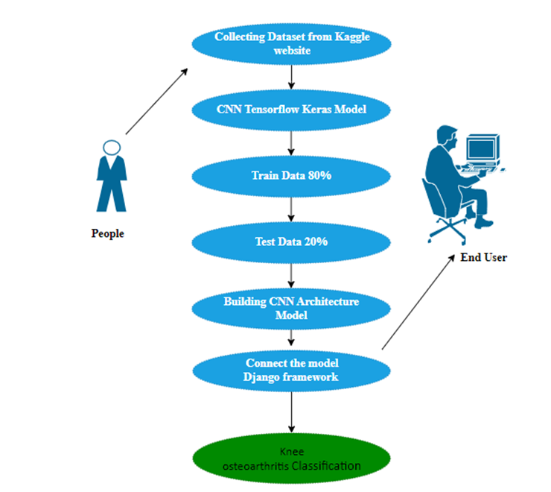
USE CASE DIAGRAM

Slide 23
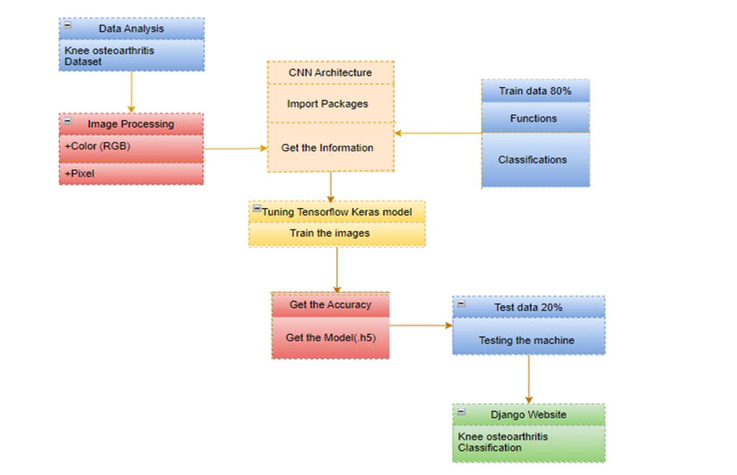
CLASS DIAGRAM:

Slide 24
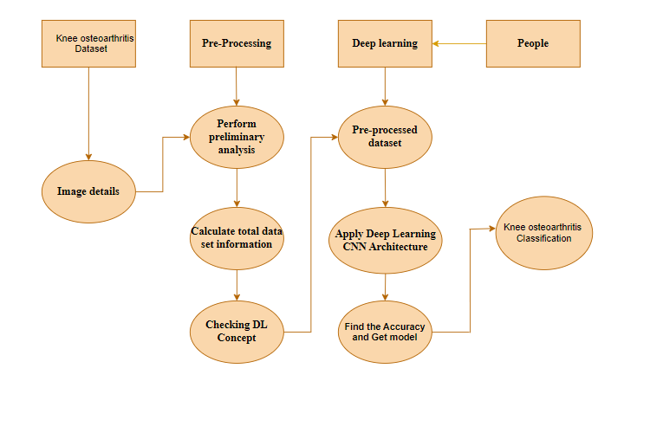

Slide 25
PROJECT REQUIREMENTS
Framework: Keras
1. Software Requirements:
Operating System : Windows
Tool : Anaconda with Jupyter Notebook
Language : Python
2. Hardware requirements:
Processor : minimum i3 and above
Hard disk : minimum 300 GB
RAM : minimum 4 GB

Slide 26
XCEPTION NET:
"Xception" is another deep learning architecture designed for image classification tasks. It was proposed by François Chollet in the research paper titled "Xception: Deep Learning with Depthwise Separable Convolutions," published in 2017. The term "Xception" is derived from the words "Extreme Inception," as it builds upon the ideas introduced in the Inception architecture.
The Xception network is inspired by the Inception architecture, which uses multiple convolutional filters of different sizes to capture features at various scales. However, instead of using traditional convolutions, Xception employs depthwise separable convolutions, which are more computationally efficient.
Here are the main features of the Xception architecture:
Depthwise Separable Convolutions: Traditional convolutions involve applying a large number of filters to input feature maps, resulting in a high computational cost. Depthwise separable convolutions break down the standard convolution operation into two separate steps: depthwise convolution and pointwise convolution.

Slide 27
Shuffle Net Architecture
ShuffleNet is developed to address the limitations of existing deep learning models on resource-constrained devices.
- It focuses on reducing the number of parameters and computation, allowing for faster inference times.
2. Key Features:
- Group Convolutions: The architecture employs group convolutions to limit the number of connections between layers. This reduces computational complexity significantly while maintaining feature representation.
- Channel Shuffle: To improve the information flow between the grouped convolutions, ShuffleNet introduces a channel shuffle operation. This operation rearranges the output of grouped convolutions, allowing for better feature reuse.
- Lightweight Design: The architecture is designed to be lightweight, making it suitable for applications on mobile devices.
3. Architecture Components:
- Input Layer: The network typically takes RGB images as input.
- Initial Convolution Layer: A standard convolution layer with a stride of 2, followed by batch normalization and a ReLU activation function.
- ShuffleNet Units: The core building block of the architecture is the ShuffleNet unit, which consists of:
- Pointwise Convolution: A 1x1 convolution that reduces the number of channels.
- Group Convolution: A 3x3 group convolution that performs convolutions on the reduced channel set

Slide 28
Conclusion
The first phase of the serverless real-time chat application was successfully implemented, establishing a secure and scalable platform. Key features, such as User Authentication and Profile Management, were integrated using Firebase and DynamoDB, ensuring a smooth onboarding process and personalized user experiences. The Real-Time Messaging module was developed with AWS API Gateway and WebSocket, enabling seamless communication. Additionally, the initial setup of the Transcription and Translation module highlighted the application’s potential to break language barriers. Overall, the first phase demonstrated the feasibility of the project in facilitating global and inclusive communication.

Slide 29
References
P. Kumar and Sheila Anand,”An Approach To Optimize Workflow Scheduling For Cloud Computing Environment”,Journal of Theoretical and Applied Information Technology,Vol.57,No 3,pp-617-623, 2013
Kumar P , Vinodh Kumar S , Priya L(2022), QoS based Classical Trust Management System for the Evaluation of the Trustworthiness of a Cloud Resource, Inventive Systems and Control, Lecture Notes in Networks and Systems, Springer, vol. 436, pp 323-344, ISSN 2367-3370, August 2022.
M. Roberts and M. Ward, "Building real-time applications on AWS: Leveraging Lambda and API Gateway for scalable messaging," IEEE Trans. Cloud Comput., vol. 10, no. 4, pp. 1156-1165, Nov. 2022.

Slide 30
References
P. Kumar, S. Senthil Pandi, T. Kumaragurubaran and V. Rahul Chiranjeevi, "Human Activity Recognitions in Handheld Devices Using Random Forest Algorithm," 2024 International Conference on Automation and Computation (AUTOCOM), Dehradun, India,
Keerthana, M., Meghana, K. J. M., Pravallika, S., &Kavitha, M. (2021, February). An ensemble algorithm for kneeostheo arthiritis prediction. In 2021 Third International Conference on Intelligent Communication Technologies andVirtual Mobile Networks (ICICV) (pp. 963-970). IEEE.Y. Zhang, K. Lee, and H.
Adler-Milstein J, DesRoches CM, Jha AK. Health information exchange among US hospitals. American Journal of Managed Care. 2011;17(11):761–768

Slide 31
Paper Publication Status
TITLE: Prediction of the 8 stages of osetoarthiritis using deep learning
AUTHOR: Dr. T. Kumaragurubaran. M.E., Ph.D.,
Dr. K. Ananthajothi B.C.A M.E M.C.A Ph.D
Dr. P. Kumar, M.E., Ph.D.,
Madhumita P
Kavya Shree BN STATUS: Yet to Publish

Slide 32
Thank You

